Slide 1
Civility Med-Fi Prototype
Team Members: Lorena Huang Liu, Steven Qian, Kate Stockdale, Jessica Xu
Notes:
o ___ Overview of talk (1 slide) – don’t read this, tell it like a story
o ___ 3 representative tasks noting key changes (1-3 slides)
o ___ Revised UI design & rationale (1-3 slides – mainly images w/ captions)
o ___ 3 scenarios shown carrying out each task w medium-fi prototype (use
screen shots and/or live demo)
o ___ Tools Used (what worked, what didn’t work, WoZ techniques) (1-3 slides)
o ___ Summary of talk (1 slide)

Slide 2
Overview
3 Representative Tasks
Revised UI Design
Medium Fidelity Prototype Walk-Through
Tools Used
Summary
Notes:
o ___ Overview of talk (1 slide) – don’t read this, tell it like a story
o ___ 3 representative tasks noting key changes (1-3 slides)
o ___ Revised UI design & rationale (1-3 slides – mainly images w/ captions)
o ___ 3 scenarios shown carrying out each task w medium-fi prototype (use
screen shots and/or live demo)
o ___ Tools Used (what worked, what didn’t work, WoZ techniques) (1-3 slides)
o ___ Summary of talk (1 slide)

Slide 3
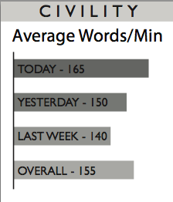
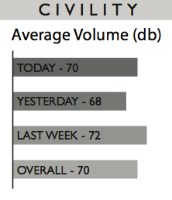
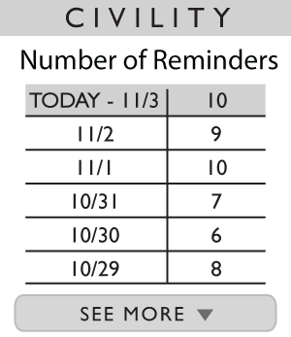
RT #1: Providing Feedback
Notes:
Top: Before
Bottom: After

Slide 4
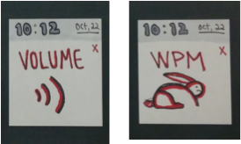
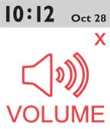
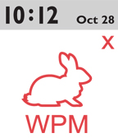
RT #2: Sending Warning Notifications

Slide 5
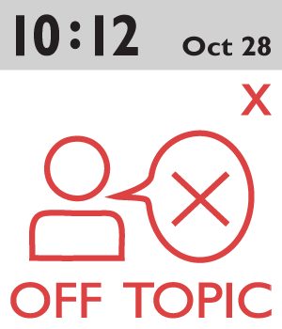
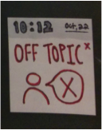
RT #3: Identifying Fruitless Conversations

Slide 6
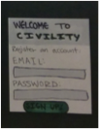
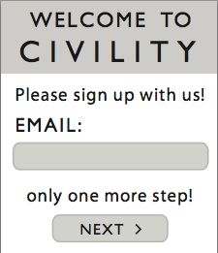
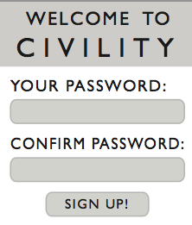
Revised UI Design: Signing Up
Before: 1 page sign up
After: 2 page sign up
Notes:
Put in the images for signing up

Slide 7
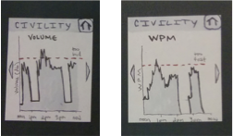
Revised UI Design: Simplified Feedback
Before: Line Graph
After: Bar Graph
Notes:
Put in the images for our simplified feedback screens

Slide 8
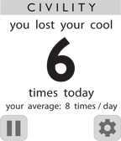
Revised UI Design: Navigation
Before: Visible Arrows
After: No Arrows
Notes:
Put in the image for homepage (without arrows)

Slide 9
DEMO
http://invis.io/7M1N5SSQ4
General Walkthrough/Feedback
Showing Warning and Off Topic Notifications
Showing Settings & Pause Feature
Notes:
http://invis.io/7M1N5SSQ4

Slide 10
Tools Used: Invision & Illustrator
Pros:
Already familiar with tools
Vector images
Easy to edit
Cons:
Had to draw every screen
No ability to do multiple actions in a row
Notes:
___ Were appropriate tools used & explained?
o ___ Were tradeoffs to using the tool discussed?
o ___ If Wizard of Oz techniques used, were they clearly explained?

Slide 11
Summary
Main changes were made in data visualization
Minor changes in UI
Prototyping to scale
Challenge designing for such a small interface

